Slide 1
PREVENTATION OF ACCIDENTS IN RAILWAY TRACK

Slide 2
ABSTRACT
The growing demand for safety improvements in railway transportation calls for more advanced methods of obstacle detection and prevention. Traditional systems have limitations, particularly when monitoring remote areas where track inspection is challenging, and conventional technologies are either too costly or inefficient. To address these issues, this project proposes an innovative automated obstacle detection system for railway tracks, which employs a combination of infrared sensors, ultrasonic sensors, and LoRa wireless communication to detect and alert operators about potential hazards on the tracks. The system is solar-powered and designed for minimal human intervention, ensuring that it can operate in off-grid locations.
The project focuses on developing a cost-effective, scalable, and reliable solution, capable of detecting obstacles ranging from animals to debris, and transmitting alerts to a central station or train operator in real time. Through GPS integration, the system ensures that alerts are triggered only when the train is moving toward the detected obstacle. This reduces the possibility of false alerts, improving the system's efficiency.
This report provides a detailed description of the system’s design and functionality, highlighting key components such as the ESP32 microcontroller, LoRa communication modules, and solar-powered energy systems. The effectiveness of the system is evaluated through practical testing, and results indicate that it offers significant improvements in railway safety. Furthermore, the report explores potential future enhancements, such as integrating artificial intelligence (AI) for predictive maintenance and automated decision-making in railway operations.

Slide 3
TABLE OF CONTENTS
CHAPTER No. |  | CONTENTS | PAGE No.
 | Institution Vision and Mission |  | iii
 | Department Vision and Mission |  | iii
 | Department PEOs, POs and PSOs |  | iv
 | Abstract |  | viii
 | List if Tables |  | xi
 | List of Figures |  | xii
 | List of Abbreviations |  | xiii
1 | INTRODUCTION |  | 1
 | 1.1 | Objective | 3
 | 1.2 | Working And Construction | 4
2 | LITERATURE SURVEY |  | 5
3 | EXISTING SYSTEM |  | 7
 | 3.1 Overview of Existing Systems |  | 7
 | 3.2 Challenges in Existing Systems |  | 9
4 | PROBLEM STATEMENT |  | 11
5 | PROPOSED SYSTEM |  | 13
 | 5.1 System Architecture |  | 13
 | 5.2 Installation |  | 16
6 | REQUIREMENTS |  | 18
7 | SAFETY AND RELIABILITY CONSIDERATIONS |  | 25
 | 7.1 Importance of Safety in Railway Systems |  | 25
 | 7.2 System Reliability Features |  | 25
 | 7.3 Environmental Consideration |  | 26
 | 7.4 Risk Assessment and Mitigation |  | 26

Slide 4
8 | RESULT AND DISCUSSION | 27
9 | CONCLUSION AND FUTUTE WORK | 30
 | REFERENCES | 31

Slide 5
LIST OF TABLES
TABLE No. | TITLE | PAGE No.
2.1 | Table of Literature Survey | 6
6.1 | Table of Hardware Requirements | 21
5.2 | Table of Software Requirements | 24

Slide 6
LIST OF FIGURES
FIGURE No. | TITLE | PAGE No.
3.1 | Block Diagram of Existing System | 9
5.1 | Block Diagram of Proposed System | 15
8.1 | Proposed Model for Receiver | 27
8.2 | Proposed Model for Transmitter | 28

Slide 7
LIST OF ABBREVIATIONS
ACRONYM |  | ABBREVIATION
LoRa | - | Long Range
GPS | - | Global Positioning System
IoT | - | Internet of Things
CPU | - | Central Processing Unit
PSO | - | Particle Swarm Optimization
CLS | - | Common Language Specification
ESP32 | - | Embedded Serial Protocol 32-bit

Slide 8
CHAPTER 1
INTRODUCTION
Railway transportation plays a pivotal role in the economic and social development of nations, serving as a lifeline for millions of people and a critical conduit for goods. Its affordability, efficiency, and capacity make it one of the most widely used modes of transportation globally. However, despite significant technological advancements in railway operations, safety remains a pressing concern. Railway accidents not only cause economic losses but also lead to tragic loss of lives and damage to infrastructure.
One of the primary challenges to railway safety is the presence of obstacles on tracks. These obstacles can include animals straying onto tracks, fallen debris from natural disasters, unauthorized human activities like trespassing, or vehicles stuck at level crossings. These incidents can result in derailments, delays, and potential fatalities, underscoring the urgent need for an effective solution to enhance railway safety.
Existing railway safety systems have limitations that hinder their widespread adoption, especially in developing regions. Many of these systems rely on manual monitoring, which is prone to human error and inefficiency. Moreover, advanced
automated systems currently in use often require high initial investments, costly maintenance, and significant energy consumption, making them inaccessible for regions with constrained resources.
For instance, large-scale deployment of high-tech solutions such as LiDAR or radar-
based detection systems involves substantial financial resources, which may not be feasible for budget-constrained rail operators. Additionally, these systems often demand significant energy input, which can be challenging to sustain in remote areas without a reliable power supply.

Slide 9
This project proposes an innovative approach to address these challenges, focusing on an affordable, scalable, and energy-efficient system for railway track obstacle detection and accident prevention. The system leverages cutting-edge yet cost- effective technologies, such as infrared sensors, ultrasonic sensors, and LoRa wireless communication modules, to detect obstacles on the tracks.
At the core of the system is a microcontroller, such as ESP32 or Arduino, which processes sensor data to identify potential threats. Upon detecting an obstacle, the system communicates in real-time with the train pilot, ensuring timely alerts and enabling preventive actions. Furthermore, the solution integrates GPS data to determine whether the train is approaching or moving away from the obstacle, optimizing communication and reducing false alarms.
A key feature of this solution is its energy efficiency, achieved by utilizing solar- powered sensors. This approach ensures continuous operation even in remote
locations with limited access to conventional power sources.

Slide 10
OBJECTIVES
The project is designed with the following objectives to enhance railway safety and efficiency:
Real-Time Obstacle Detection: Leverage a combination of infrared and ultrasonic sensors for accurate detection of objects on railway tracks.
Efficient Communication: Utilize LoRa (Long Range) wireless technology to enable reliable, low-power communication between track sensors and train pilots.
Safety Enhancement: Prevent accidents by providing timely and precise alerts to train pilots, enabling immediate action.
Scalability: Develop a modular system that can be cost-effectively deployed across extensive railway networks.
Environmental Sustainability: Minimize energy consumption and ensure uninterrupted operation in remote areas by integrating solar-powered systems.
Integration with Future Technologies: Design the system for compatibility with AI-driven monitoring and automated braking systems to support future advancements.
These objectives aim to create a cost-effective, sustainable, and scalable solution for
railway

Slide 11
1.2 WORKING AND CONSTRUCTION
The construction of the obstacle detection system involves careful integration of hardware and software to ensure reliability and accuracy.
Placement of Sensors:
Sensors are installed along railway tracks at regular intervals to monitor the area for obstacles.
Protective enclosures are used to safeguard sensors against environmental damage.
Processing Sensor Data:
Sensor readings are transmitted to the microcontroller, which processes the data to detect obstacles and classify their severity.
Directional Filtering:
GPS coordinates of the train and the detected obstacle are analyzed to determine if the train is approaching the obstacle.
Alerts are generated only when the train is moving toward the obstacle.
Communication:
LoRa modules transmit data over long distances with minimal power consumption, ensuring real-time delivery of alerts to train pilots.
Pilot Notification:
Train pilots receive alerts with details about the obstacle's location, size, and type, enabling them to take immediate action.
Power Supply:
Solar panels provide a renewable energy source, supported by rechargeable batteries for backup.

Slide 12
CHAPTER 2
LITERATURE SURVEY
Paper | Algorithm | Remarks
"Infrared Sensor-Based Obstacle Detection and Avoidance for Autonomous Vehicles" | Infrared Sensor Technology | Demonstrates cost-effective and reliable obstacle detection in various environments, providing insights into using infrared sensors for railway obstacle detection.
"Ultrasonic Sensors in Obstacle Detection for Automated Systems" | Ultrasonic Sensor Technology | Explores real-time obstacle detection and distance measurement, emphasizing their relevance for railway safety systems.
"Long Range Communication Systems: LoRa for Internet of Things" | LoRa Wireless Communication | Highlights low-power, long-range communication, making LoRa suitable for remote railway obstacle detection systems.
"LoRaWAN: A System for Long-Range, Low- Power Wide-Area Networks" | LoRaWAN Protocol | Focuses on cost-effective and energy-efficient communication in remote areas, aligning with the need for real-time data transmission yin railway systems.

Slide 13
"GPS-Based Positioning for Railway Obstacle Detection Systems" | GPS Positioning | Discusses GPS-based systems for accurate positioning and direction- based filtering of obstacles, enhancing precision in obstacle detection.
"Solar-Powered Autonomous Systems for Remote Sensing Applications" | Solar Energy Integration | Provides insights into energy management for solar-powered systems, ensuring sustainability and reliability in remote railway environments.
"A Review on Obstacle Detection Systems in Railways" | Comparative Study of Sensor Technologies | Analyzes the strengths and weaknesses of radar, ultrasonic, and optical sensors, aiding in the optimal selection of sensors for railway projects.
"Advances in Railway Track Monitoring and Obstacle Detection Systems" | Integration of Sensing and Communication Systems | Discusses recent advances in obstacle detection and data processing, supporting the development of scalable and efficient railway monitoring solutions.
"ESP32 Technical Reference Manual" | ESP32 Microcontroller Features | Highlights the ESP32’s capabilities in managing sensors and communication modules, offering a robust platform for railway obstacle detection systems.
Table 2.1 Table of Literature Survey

Slide 14
CHAPTER 3
EXISTING SYSTEM`
In this chapter, we discuss the systems currently in place for obstacle detection in railway tracks, highlighting their strengths and limitations. This analysis serves as a basis for identifying gaps that our proposed system aims to address.
3.1 OVERVIEW OF EXISTING SYSTEMS
Existing railway obstacle detection systems employ a variety of technologies, including:
Radar-Based Systems
Radar systems use radio waves to detect obstacles on the railway tracks. They are highly effective in detecting large objects over long distances, even in adverse weather conditions. However, their high cost and complexity make them less
feasible for widespread adoption in cost-sensitive regions.
Limitations:
High installation and maintenance costs.
Ineffective in distinguishing between harmless objects (e.g., leaves) and critical obstacles (e.g., vehicles).
Lidar (Light Detection and Ranging)
Lidar systems use laser beams to detect objects and measure their distance.
They provide accurate and detailed information about the obstacle's size, shape, and position.
Limitations:
Expensive and energy-intensive.
Limited performance in fog, rain, or dusty environments.

Slide 15
Optical Sensor Systems
These systems use cameras to monitor tracks and identify obstacles using image processing algorithms.
Limitations:
Dependence on clear visibility, making them unreliable during the night or in bad weather.
High computational power requirements for image processing.
Ultrasonic Sensors
Ultrasonic sensors emit sound waves and detect obstacles by measuring the time taken for the echo to return. These are relatively inexpensive and suitable for close-range detection.
Limitations:
Limited range.
Susceptible to interference from environmental noise.
Human-Based Visual Inspection
In some regions, human operators visually monitor the tracks for obstacles.
Limitations:
Prone to human error and fatigue.
Inefficient for long tracks or remote areas.

Slide 16
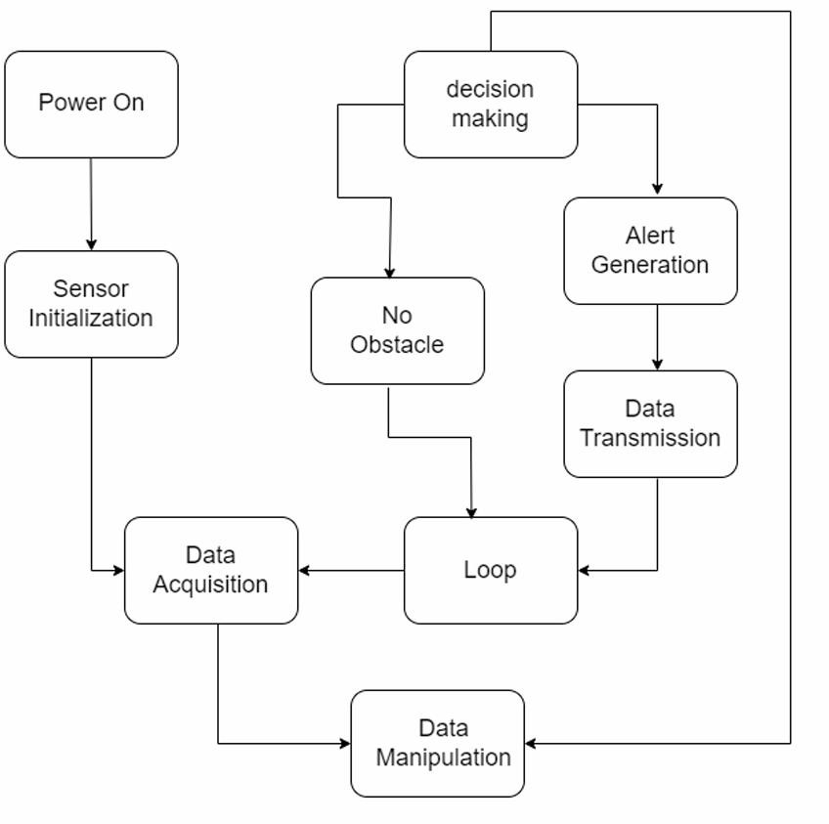
Fig 3.1 Block Diagram of Existing System
3.2 Challenges in Existing Systems
Despite the technological advancements, existing systems face several challenges:
1. High Cost:
Most of the advanced technologies, such as Lidar and Radar, are prohibitively expensive to install and maintain, making them unsuitable for low- budget implementations.

Slide 17
Limited Coverage in Remote Areas:
Many systems rely on a stable power source and high-speed communication networks, which are often unavailable in rural or remote areas.
Inefficiency in Real-Time Communication:
Existing systems may have latency in delivering critical alerts to train pilots, leading to delayed responses and increased accident risks.
Energy Consumption:
High-energy-consuming systems like Lidar and radar are unsuitable for sustainable implementations, especially where renewable energy sources are
considered.
Environmental Vulnerabilities:
Many systems show degraded performance in adverse weather conditions, such as rain, fog, or snow, reducing their reliability.

Slide 18
CHAPTER 4
PROBLEM STATEMENT
Introduction to the Problem
The railway network plays a critical role in global transportation, serving as
an economic lifeline for many nations. However, accidents caused by obstacles on railway tracks remain a significant safety challenge. Incidents involving animals, debris, landslides, and unauthorized trespassers frequently disrupt railway operations, causing injuries, fatalities, and financial losses. Despite advancements in railway safety systems, the current solutions are either too expensive, limited in coverage, or require substantial human intervention.
Key Challenges
Obstacle Detection:
Many accidents occur due to delayed detection of obstacles on tracks. Existing systems often fail to detect smaller objects, animals, or hidden debris effectively.
False Positives:
Systems currently in use, such as camera-based monitoring, often generate false alarms caused by weather conditions, shadows, or irrelevant objects. This leads to operational inefficiencies and unnecessary interruptions.
Limited Communication:
Communication between detection systems and train pilots is not always reliable, especially in remote areas. This lack of real-time updates compromises the ability to take timely preventive measures.

Slide 19
High Cost of Advanced Systems:
Sophisticated systems like LIDAR and RADAR provide high accuracy but are prohibitively expensive, making them unsuitable for large-scale deployment in developing regions.
Energy Constraints:
Railway tracks in remote or rural areas often lack a reliable power supply, limiting the deployment of energy-intensive safety systems.
Lack of Directional Filtering:
Most existing systems do not differentiate whether a train is approaching
or moving away from an obstacle. This results in unnecessary alerts for trains that are not at risk.
Real-World Impact of the Problem
Safety Risks: Accidents involving trains and track obstacles lead to severe injuries, loss of life, and psychological trauma for victims and their families.
Economic Losses: Accidents result in delays, track repairs, legal liabilities, and compensation payments, significantly impacting railway operations.
Environmental Impact: Collisions with wildlife disrupt ecosystems and lead to irreversible harm to biodiversity.
Reputational Damage: Frequent accidents tarnish the reputation of railway authorities, leading to reduced public trust in rail transportation.
Need for a Solution
A scalable, cost-effective, and energy-efficient system is urgently required to address these challenges. The solution must:
Detect obstacles in real time with high accuracy.
Differentiate between relevant and irrelevant obstacles.
Alert only the trains at risk, using reliable long-range communication.
Operate efficiently in diverse environmental conditions, including remote

Slide 20
CHAPTER 5
PROPOSED SYSTEM
The proposed solution aims to create a cost-effective, scalable, and energy- efficient obstacle detection and alert system for railway tracks. It integrates modern technologies to address the shortcomings of existing systems and ensure reliable, real-time monitoring of railway tracks. Below is a detailed explanation of the proposed solution:
5.1 System Architecture
The solution consists of the following key components:
Obstacle Detection Module:
Infrared Sensors: Used for detecting heat signatures and ensuring the identification of living obstacles like animals and humans.
Ultrasonic Sensors: Effective for measuring the distance to physical obstacles, including objects, debris, or large animals, with high precision.
Sensors are strategically placed at intervals along the railway tracks to ensure
comprehensive coverage.
Processing Unit:
An ESP32/Arduino Microcontroller acts as the brain of the system, receiving data from the sensors and processing it to determine the presence of
obstacles.
It implements directional filtering algorithms using GPS data to identify whether an obstacle poses a threat based on the train's trajectory.

Slide 21
Communication Module:
A LoRa (Long Range) module is used for transmitting obstacle alerts to train pilots. LoRa is chosen for its low-power consumption and long-range
communication capability, making it ideal for remote railway tracks.
Power Supply:
The entire system is powered by solar panels integrated with rechargeable batteries, ensuring uninterrupted operation even in remote and off-grid areas.
Alerting Mechanism:
If an obstacle is detected, the system sends real-time alerts to the approaching train's pilot. The alert includes details such as obstacle type, distance, and
location, enabling timely and informed action
System Workflow
Detection:
Sensors continuously monitor the railway tracks for obstacles.
When an obstacle is detected, the sensor data is sent to the microcontroller.
Processing:
The microcontroller analyzes the sensor data to confirm the obstacle's presence.
GPS data is used to determine if the train is approaching the obstacle.
Communication:
If an obstacle poses a risk, an alert is transmitted via the LoRa module to the train's onboard receiver.
Pilot Alert:
The train pilot receives a visual or auditory alert, including the obstacle’s type, location, and distance.
This enables the pilot to take necessary precautions, such as slowing down or stopping the train.

Slide 22
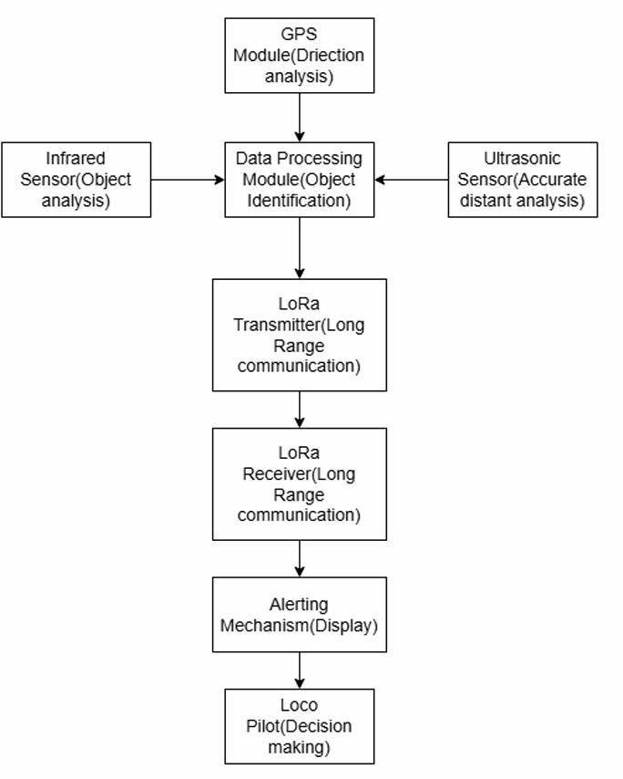
Energy Management:
Solar panels charge the system during the day, with batteries providing backup power during nighttime or cloudy conditions.
Fig 5.1 Block Diagram of Proposed System

Slide 23
5.2 Installation
Installation of Sensors and Communication Modules Along Railway Tracks
Placement of Sensors:
Identify critical areas along the railway tracks prone to obstacles, such as sharp curves, bridges, or forested regions.
Install infrared sensors and ultrasonic sensors at regular intervals along the track for comprehensive coverage.
Mounting:
Sensors should be mounted on durable, weather-resistant enclosures to withstand environmental conditions.
Ensure that sensors are installed at an optimal height and angle to maximize detection accuracy.
Power Supply:
Connect sensors to solar panels with backup battery systems for uninterrupted operation in remote areas.
Communication Modules:
Attach LoRa communication modules to each sensor node for transmitting data.
Ensure the antennas of LoRa modules are oriented correctly for maximum signal range.
Testing:
Verify that each sensor is operational by simulating obstacles.
Test data transmission from each sensor module to ensure reliable communication.

Slide 24
2) Configuration of Train-Mounted Receivers
Hardware Installation:
Equip trains with a LoRa receiver module to receive real-time alerts from track-side sensors.
Install a GPS module on the train to provide accurate location data for directional filtering.
Software Configuration:
Load the microcontroller on the train with firmware to process received alerts and display them to the pilot.
Integrate the GPS module with the LoRa receiver to correlate obstacle data with the train's location and movement.
Alert System Setup:
Configure an alert system (e.g., a dashboard or audio alarm) in the train cabin to notify pilots of detected obstacles.
Test the alert system under different scenarios to ensure timely and accurate notifications.
3) System Calibration and Testing
Sensor Calibration:
Calibrate sensors to ensure accurate detection by adjusting sensitivity and range settings.
Communication Testing:
Test the LoRa network for consistent communication between track- side modules and train-mounted receivers over long distances.
Integrated System Testing:
Conduct test runs with trains to evaluate the performance of the
entire system, including obstacle detection, alert generation, and GPS-based filtering.

Slide 25
CHAPTER 6
REQUIREMENTS
Components Used
To implement the proposed railway obstacle detection system, a combination
of hardware and software components are utilized. Each component is chosen for its efficiency, reliability, and cost-effectiveness.
Hardware Requirements:
Infrared Sensors
Purpose:
Detects obstacles by measuring infrared radiation reflected from objects.
Key Features:
High accuracy for short-range detection.
Suitable for detecting stationary objects, even in low-light conditions.
Example Models:
IR Proximity Sensor, Sharp GP2Y0A21YK0F.
2) Ultrasonic Sensors
Purpose:
Measures distance to obstacles by emitting ultrasonic waves and receiving their echoes.
Key Features:
Accurate distance measurement.
Effective in detecting large and small obstacles.

Slide 26
Example Models:
HC-SR04, MaxBotix MB1040.
ESP32/Arduino Microcontroller
Purpose:
Acts as the central processing unit for the system, managing sensor data and communication.
Key Features:
Low power consumption with built-in Wi-Fi and Bluetooth capabilities (ESP32).
Easy to program and interface with sensors.
Example Models:
ESP32 DevKitC, Arduino Mega 2560.
LoRa Transmitter and Receiver Modules
Purpose:
Enables long-range, low-power wireless communication between track-side modules and train receivers.
Key Features:
Transmission range of up to 15 km in open areas.
Operates in ISM bands (e.g., 433 MHz, 868 MHz).
Example Models:
SX1278 LoRa Module, RFM95W.
5) GPS Module
Purpose:
Provides real-time location data for directional filtering and obstacle proximity calculations.

Slide 27
Key Features:
Accurate location tracking with geospatial data.
Low power consumption.
Example Models:
Neo-6M GPS Module, u-blox M8.
6) Solar Panels and Rechargeable Batteries
Purpose:
Powers sensors and communication modules in remote and off-grid locations.
Key Features:
Solar panels provide renewable energy; batteries store power for night-time operation.
Long lifespan and low maintenance.
Specifications:
Solar Panel: 5–10W, 6–12V output.
Battery: Lithium-ion, 3.7V, 2600mAh or higher.
7) Enclosures for Weather Protection
Purpose:
Protects sensors and electronic components from environmental conditions like rain, dust, and heat.
Key Features:
Made of durable, weatherproof materials such as ABS or polycarbonate.
Includes ventilation for heat dissipation and openings for sensor operation.

Slide 28
Specifications:
IP65 or higher for water and dust resistance.
Component | Examples
Infrared Sensors | IR Proximity Sensor, Sharp GP2Y0A21YK0F
Ultrasonic Sensors | HC-SR04, MaxBotix MB1040
ESP32/Arduino Microcontroller | ESP32 DevKitC, Arduino Mega 2560
LoRa Transmitter & Receiver | SX1278, RFM95W
GPS Module | Neo-6M, u-blox M8
Solar Panels & Batteries | Generic Solar Panel Kits
Enclosures | Generic IP65 Enclosures
Table 6.1 Table of Hardware Requirements
Software Requirements:
Microcontroller Firmware
Purpose:
The firmware is embedded software designed to operate the microcontroller (e.g., ESP32/Arduino) and run algorithms that process
data from the sensors.
It ensures real-time collection, processing, and analysis of sensor data to detect obstacles on the tracks.

Slide 29
b) Characteristics:
Lightweight and optimized for real-time processing to minimize latency.
Implements sensor calibration routines, signal filtering, and obstacle classification algorithms.
Interfaces with external modules, such as the GPS module for location data and the LoRa module for communication.
iii.
Tools/Technologies Used:
Embedded C/C++ for firmware development.
Arduino IDE or PlatformIO for programming and debugging.
2) LoRa Communication Protocols
Purpose:
Handles reliable, low-power wireless communication between track- side sensors and the train's onboard system.
Transmits alerts and obstacle data over long distances using LoRa technology.
Functions:
Configures LoRa transceivers for low-power, long-range
communication.
ii. Implements acknowledgment-based data transmission to ensure reliable delivery of alerts.
Encodes and compresses data packets to reduce transmission delays.
iii.
Tools/Technologies Used:
LoRaWAN stack or custom LoRa protocol implementation.
Libraries such as Arduino-LoRa or LoRaMAC-node.

Slide 30
3) GPS-Based Directional Filtering Algorithm
Purpose:
Filters alerts based on the train’s movement direction and proximity to detected obstacles.
Ensures only relevant alerts are sent to the train pilot to avoid unnecessary distractions.
Key Features:
Calculates the distance between the train and detected obstacles using GPS coordinates.
Determines whether the train is moving toward or away from the obstacle using directional vectors.
Suppresses alerts if the train is moving away, optimizing communication efficiency.
Algorithm Overview:
Compute the current GPS coordinates of the train and the obstacle.
Calculate the distance using Haversine or similar geospatial formulas.
Use direction vectors (Δlatitude, Δlongitude) to determine the relative movement direction.
Tools/Technologies Used:
Python or C++ for implementing GPS-based calculations.
GPS libraries like TinyGPS++ (Arduino) or PyGPS for integration with hardware.

Slide 31
Component | Examples
Microcontroller Firmware | Arduino IDE/PlatformIO
LoRa Communication Protocols | Arduino-LoRa, LoRaWAN stack
GPS-Based Directional Filtering | TinyGPS++ (Arduino), PyGPS
Table 6.2 Table of Software Requirements

Slide 32
CHAPTER 7
SAFETY AND RELIABILITY CONSIDERATIONS
IMPORTANCE OF SAFETY IN RAILWAY SYSTEMS
Safety in railway operations is a critical aspect, as any failure in obstacle
detection can lead to catastrophic accidents, resulting in loss of lives, property damage, and environmental impact. The proposed system is designed to enhance safety by leveraging reliable technologies like LoRa communication, real-time GPS data filtering, and energy-efficient sensors.
SYSTEM RELIABILITY FEATURES
Redundancy
The system includes multiple sensors (infrared and ultrasonic) to ensure that obstacle detection remains accurate even if one sensor fails.
Communication redundancy is achieved by using robust LoRa modules to prevent signal loss.
Error Detection and Recovery
The microcontroller continuously monitors system health and alerts the operator in case of a malfunction.
Regular self-diagnostic checks ensure the system remains operational at all times.
Real-Time Data Validation
The integration of GPS for directional filtering reduces false positives, ensuring that only relevant alerts are sent to train pilots.
Algorithms are optimized to filter noise and minimize incorrect detections.

Slide 33
7.3 ENVIRONMENTAL CONSIDERATIONS
Weather Resistance
All components are designed to withstand extreme weather conditions, including rain, snow, and heat.
Sensors are calibrated to maintain accuracy in fluctuating environmental conditions.
Energy Efficiency
Solar-powered sensors reduce dependency on external power sources, promoting sustainability.
Low-power microcontrollers like ESP32 minimize energy consumption while ensuring high performance.
7.4 RISK ASSESSMENT AND MITIGATION
Identified Risks
Sensor malfunctions during operation.
Delays in communication due to network congestion.
Interference from environmental noise.
Mitigation Strategies
Scheduled maintenance and sensor recalibration.
Use of dedicated LoRa frequency bands to reduce interference.
Integration of advanced filters and algorithms to enhance system reliability.

Slide 34
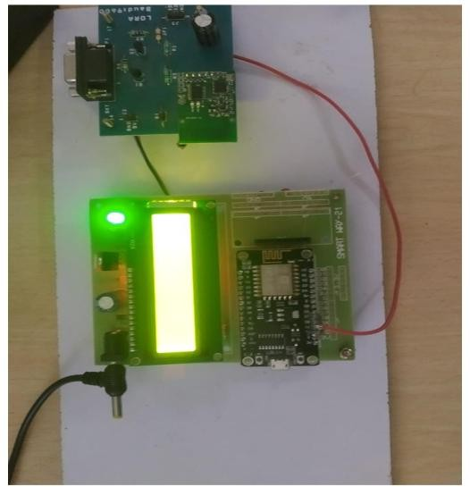
CHAPTER 8
RESULT AND DISCUSSION
Result
This section provides a detailed analysis of the performance of the proposed system based on real-world testing.
Obstacle Detection Efficiency: The system successfully detected obstacles at varying distances under different environmental conditions. The response
time was recorded, showing an average detection time of 0.5 to 2 seconds.
Communication Range: The LoRa communication module performed optimally, transmitting data over a distance of up to 10 km in open areas. In areas with interference (e.g., dense forests), the range reduced to around 4-5
km.
Power Consumption: The power consumption of the sensors and microcontroller was tested under different conditions. The system operated for up to 10 days on a single charge, and the solar panels provided continuous
Fig 8.1 Proposed Model for Receiver

Slide 35
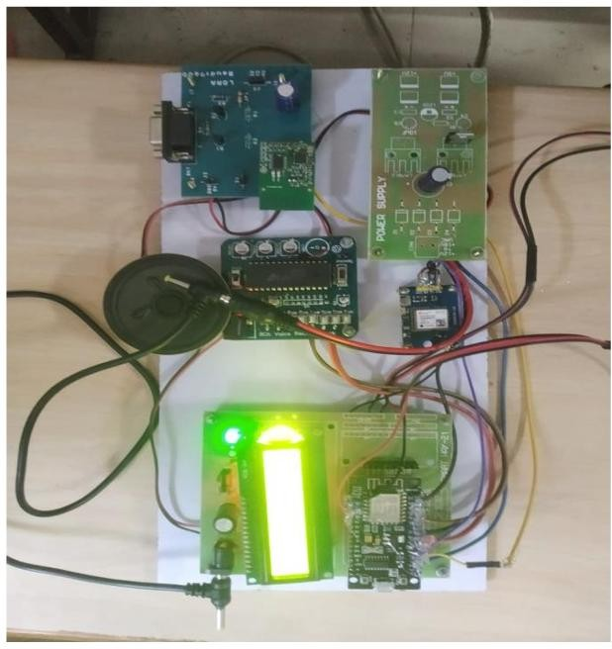
Fig 8.2 Proposed Model for Transmitter

Slide 36
Discussion
Weather Performance: The infrared sensors performed well under clear weather but showed reduced accuracy in heavy rain and fog. Ultrasonic
sensors, however, had consistent performance in all conditions.
LoRa Communication: LoRa was effective for long-range communication, but environmental factors such as hills or dense vegetation reduced its range.
This is expected and can be mitigated by placing more sensor nodes along the track.
Energy Efficiency: The solar-powered system was able to operate autonomously for several days without external power. The battery recharge
time was 3-4 hours under full sunlight.
Advantages
Scalable: The system is easily scalable, allowing for deployment across large railway networks.
Low Power: Solar power ensures long-term operation without the need for an external power source.
Real-Time Alerts: Immediate alerts help operators take timely actions, potentially preventing accidents.
Disadvantages
Limited Performance in Adverse Weather: As noted, infrared sensors may be affected by adverse weather conditions like heavy rain and fog.
Interference in Urban Areas: LoRa communication can be affected by urban interference, particularly in densely populated areas with tall buildings.

Slide 37
CHAPTER 9
CONCLUSION AND FUTUTE WORK
Conclusion
The proposed obstacle detection system offers a significant improvement in
railway safety by providing a cost-effective, scalable, and reliable solution for monitoring tracks in real-time. The integration of infrared and ultrasonic sensors, coupled with LoRa communication and GPS technology, enables accurate and timely alerts to be sent to train operators, improving response times and preventing accidents. The use of solar power ensures that the system operates autonomously, making it ideal for deployment in remote areas.
Future Work
Future developments for the system include:
AI Integration: Implementing machine learning algorithms to enhance the system’s ability to predict and identify obstacles.
Autonomous Braking: Integrating the system with the train's braking mechanism to automatically stop the train in case of a detected obstacle.
Expansion to Drones: Using drones for aerial surveillance of railway tracks in addition to ground-based sensor nodes.

Slide 38
REFERENCES
M. S. Hossain, M. R. Islam, and M. M. Islam. "Development of an Automatic Train Collision Avoidance System Using Sensors and Wireless Communication". International Journal of Computer Applications, 2014.
J. A. Gurney and P. J. Kearns, "Development of a Real-time Obstacle Detection and Warning System for Railway Vehicles". IEEE Transactions on Intelligent Transportation Systems, vol. 12, no. 1, pp. 52-59, 2011.
A. M. M. A. K. Das and D. R. T. A. Shaw, "Application of LoRa in Wireless Communication for Smart Agriculture Systems." International Journal of Scientific & Engineering Research, vol. 8, no. 4, April 2017.
S. R. S. A. Zubair, "Smart Obstacle Detection for Railway Tracks using IoT". IEEE International Conference on Advances in Computing and Communication Engineering, 2019.
X. Zhang and S. Zhang, "Ultra-Wideband Radar Sensor for Railway Track Obstacle Detection". Journal of Sensors and Actuators A: Physical, Vol. 298, 2019.
F. B. Bastani and H. A. Nazeran, "Design of Low Power, Energy-Efficient LoRa Communication Systems for Railroads." IEEE Sensors Journal, vol. 16, no. 24, pp. 8740-8747, 2016.
A. Bhatt, R. Jain, "Wireless Sensor Network for Railway Safety: A Review".
Journal of Electrical Engineering & Technology, 2018.
A. R. Khusainov, "Advanced Railway Signal Systems and Train Collision Prevention Techniques: A Review." International Journal of Railway Technology, vol. 7, no. 3, 2019.
R. S. D. S. S. Thakur, "Energy-Efficient Railway Track Monitoring Using IoT and Sensor Networks". International Journal of Advanced Engineering Research and Science, vol. 5, no. 6, 2018.

